Slide 1
Diabetes Predictor
Presented by: Submitted to:
Siddhant Kaushik (10717210049) Mr. Puneet sir
Yash Saraf (10717210056)
Sarthak Seth (10717210045)

Slide 2
Aim & Objectives
Aim: To develop a web application which can be easily used for prediction whether a lady is suffering with diabetes or not.
Objective:
To create web application using HTML & CSS
Use Machine Learning for prediction of diabetes
Flask which could provide an API to connect web page and Machine Learning model.

Slide 3
About The Project
It is a web application project which is used to predict weather a women in suffering from diabetes of not. We have used a PIMA diabetes data set from kaggle which consists of 2000 rows and 9 columns. We have used machine learning algorithm to create a model which will predict weather a person have diabetes or not. Then used HTML (Hypertext Transfer Protocol) which is used for creating for a web page.CSS (Cascading style sheet) is used for designing the web page. Web page is a front-end which is directly accessible by the user and machine learning is the back-end which is used for future prediction but the Flask is used for connecting both. Flak provide API which links both front-end and back-end

Slide 4
Technologies Used
Random Forest Classifier: Random forests is a supervised learning algorithm. It can be used both for classification and regression. It is also the most flexible and easy to use algorithm. Random forests creates decision trees on randomly selected data samples, gets prediction from each tree and selects the best solution by means of voting. It also provides a pretty good indicator of the feature importance.Random forests has a variety of applications, such as recommendation engines, image classification and feature selection. It can be used to classify loyal loan applicants, identify fraudulent activity and predict diseases. It lies at the base of the Boruta algorithm, which selects important features in a dataset.

Slide 5
It works in four steps:
Select random samples from a given dataset.
Construct a decision tree for each sample and get a prediction result from each decision tree.
Perform a vote for each predicted result.
Select the prediction result with the most votes as the final prediction.
Random Forest doesn’t suffer from the overfitting problem. The main reason is that it takes the average of all the predictions, which cancels out the biases.

Slide 6
Pickle: The Python pickle module is another way to serialize and deserialize objects in Python. It differs from the json module in that it serializes objects in a binary format, which means the result is not human readable. However, it’s also faster and it works with many more Python types right out of the box, including your custom-defined objects. Pickling is a way to convert a python object (list, dict, etc.) into a character stream. The idea is that this character stream contains all the information necessary to reconstruct the object in another python script.

Slide 7
JSONIFY: jsonify is a function in Flask's flask.json module. jsonify serializes data to JavaScript Object Notation (JSON) format, wraps it in a Response object with the application/json mimetype.jsonify is sometimes imported directly from the flask module instead of from flask.json. It is the same function that is imported, but there are less characters to type when you leave off the .json part.

Slide 8
HTML
HTML is an acronym which stands for Hyper Text Markup Language which is used for creating web pages and web applications. Let's see what is meant by Hypertext Markup Language, and Web page.
A markup language is a computer language that is used to apply layout and formatting conventions to a text document. Markup language makes text more interactive and dynamic. It can turn text into images, tables, links, etc.

Slide 9
CSS: CSS is the language for describing the presentation of Web pages, including colors, layout, and fonts. It allows one to adapt the presentation to different types of devices, such as large screens, small screens, or printers. CSS is independent of HTML and can be used with any XML-based markup language. The separation of HTML from CSS makes it easier to maintain sites, share style sheets across pages, and tailor pages to different environments. This is referred to as the separation of structure (or: content) from presentation.

Slide 10
It works in four steps:
Select random samples from a given dataset.
Construct a decision tree for each sample and get a prediction result from each decision tree.
Perform a vote for each predicted result.
Select the prediction result with the most votes as the final prediction.
Random Forest doesn’t suffer from the overfitting problem. The main reason is that it takes the average of all the predictions, which cancels out the biases.

Slide 11
Flask: Flask is a popular Python web framework, meaning it is a third-party Python library used for developing web applications.Flask’s framework is more explicit than Django’s framework and is also easier to learn because it has less base code to implement a simple web-Application. A Web-Application Framework or Web Framework is the collection of modules and libraries that helps the developer to write applications without writing the low-level codes such as protocols, thread management, etc. Flask also has a built-in development server and fast debugger.

Slide 12
Advantages
Used in medical support
Effectively and faster prediction using Machine Learning Algorithm
After deployment it can be used by everyone from anywhere

Slide 13
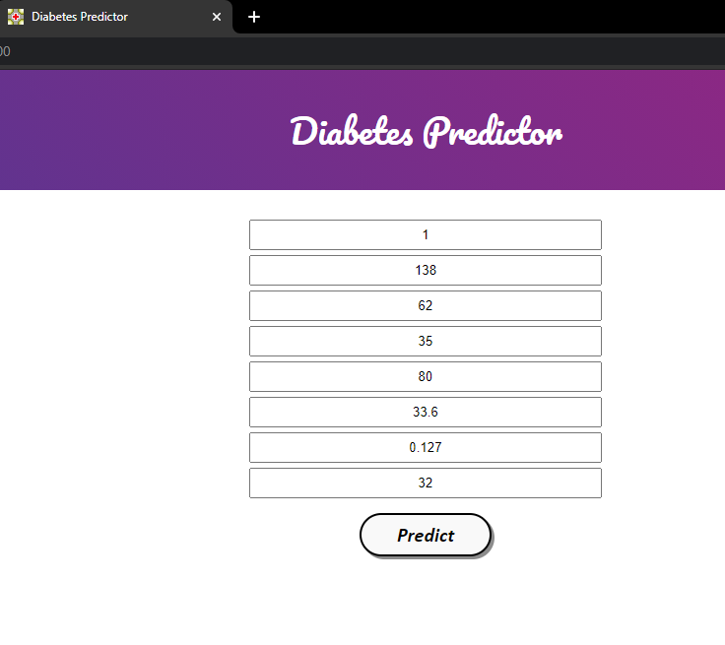
Result

Slide 14
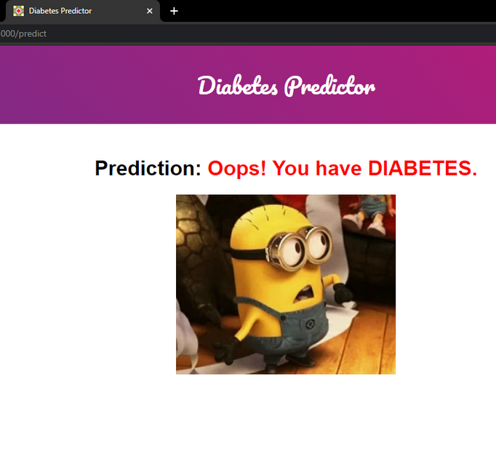

Slide 15
Future Scope
Currently, we have taken a Female dataset in our project. But for future scope we can add multiple datsets for males, adults, senior citizens. We can also improve some other functionalities and styling techniques. We can also make it as a full-fledged app in the future.

